Slide 1
Optimized numerical simulation of temperature-controlled systems
By Thomas Loke (University of Western Australia)
Supervised by: Prof. Hisashi Okumura

Slide 2
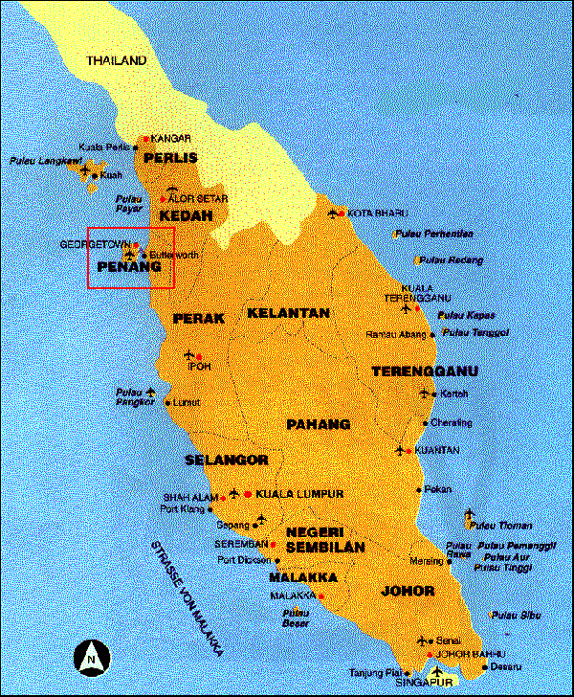
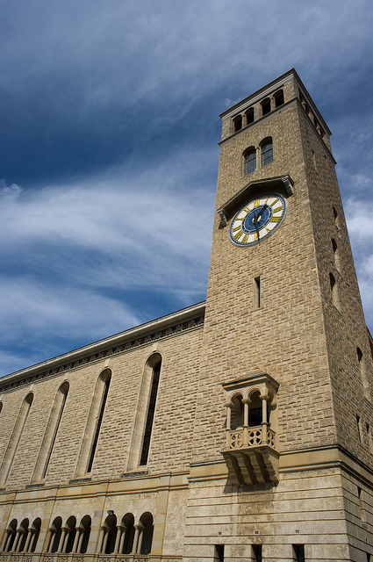
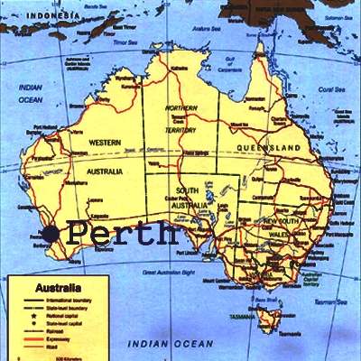
1) Introduction

Slide 3
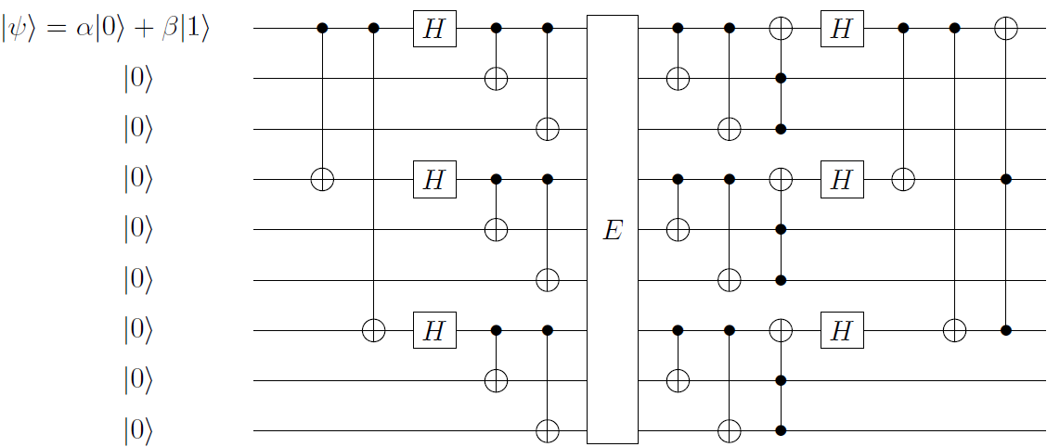
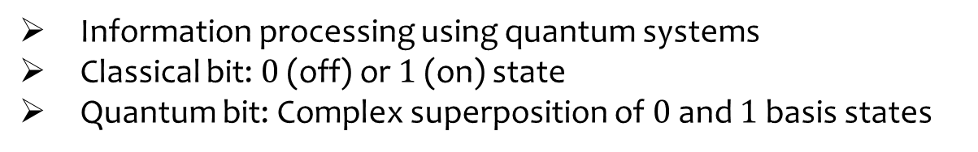


2) Current work at UWA: Quantum computation
Information processing using quantum systems
Classical bit: $0$ (off) or $1$ (on) state
Quantum bit: Complex superposition of $0$ and $1$ basis states
$\left|ψ\right\rangle =α\left|0\right\rangle +β|1⟩$,
$${|α|}^{2}+{|β|}^{2}=1$$

Slide 4
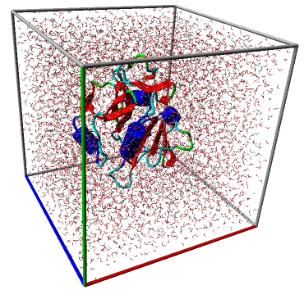
3) Current work at IMS: MD simulations
Molecular dynamics: Simulating the dynamics of a large number of interacting particles under the influence of some prescribed environment.
Basically: n-body simulator + environmental interaction
Can be applied to simulate biomolecules (figure shows the enzyme dihydrofolate reductase in water [1])
[1] Sourced from http://www.yasara.org/benchmarks.htm

Slide 5
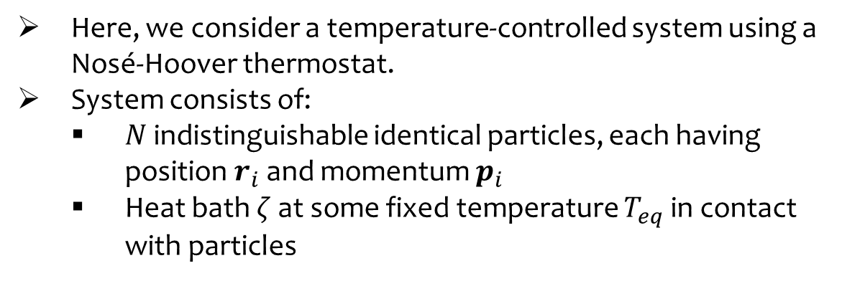
3) Current work at IMS: MD simulations
Here, we consider a temperature-controlled system using a Nosé-Hoover thermostat.
System consists of:
$N$ indistinguishable identical particles, each having position $r_{i}$ and momentum $p_{i}$
Heat bath $ζ$ at some fixed temperature $T_{eq}$ in contact with particles

Slide 6
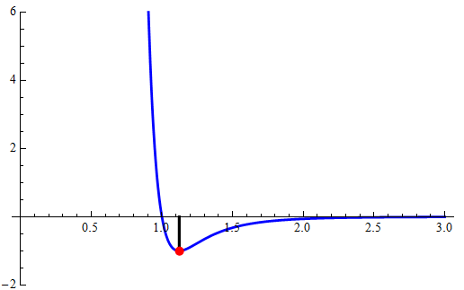
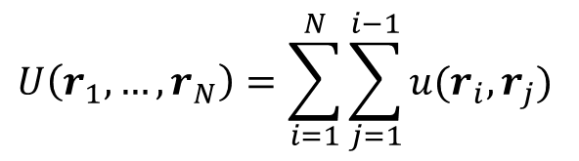
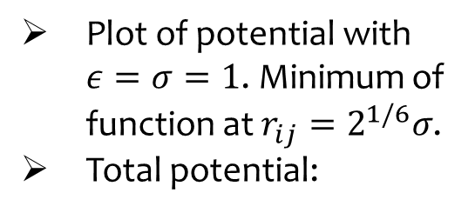

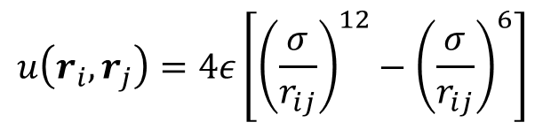
3) Current work at IMS: MD simulations
Interaction between particles: The 12-6 Lennard-Jones potential
Applies to interacting neutral atoms/molecules
$$u\left(r_{i},r_{j}\right)=4ε\left[{\left(\frac{σ}{r_{ij}}\right)}^{12}−{\left(\frac{σ}{r_{ij}}\right)}^{6}\right]$$
$$r_{ij}=|r_{i}−r_{j}|$$
Plot of potential with $ε=σ=1$. Minimum of function at $r_{ij}=2^{1/6}σ$.
Total potential:
$$U\left(r_{1},…,r_{N}\right)=\sum_{i=1}^{N}{\sum_{j=1}^{i−1}{u(r_{i},r_{j})}}$$

Slide 7

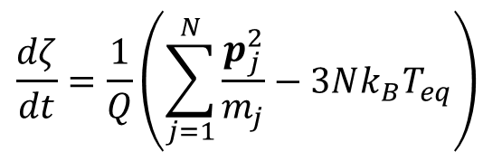


3) Current work at IMS: MD simulations
Time-evolution of system determined by equations of motion for the set of $6N+1$ variables $\left(r_{i},p_{i},ζ\right)$:
where $F_{i}=−\frac{dU}{dr_{i}}$ is the force acting on particle $i$.
$$\frac{dr_{i}}{dt}=\frac{p_{i}}{m_{i}}$$
$$\frac{dp_{i}}{dt}=F_{i}−ζp_{i}$$
$$\frac{dζ}{dt}=\frac{1}{Q}\left(\sum_{j=1}^{N}{\frac{p_{j}^{2}}{m_{j}}}−3Nk_{B}T_{eq}\right)$$

Slide 8
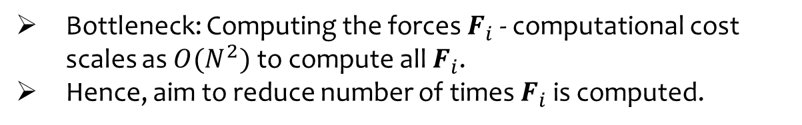
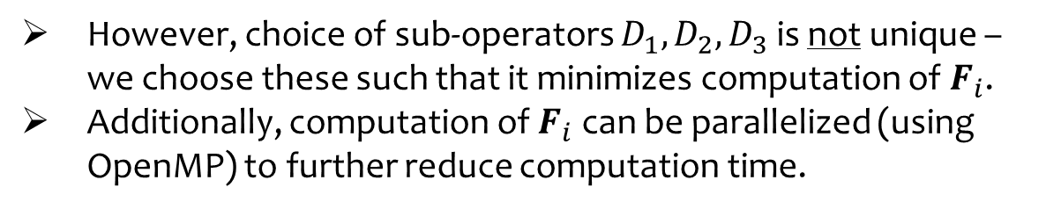
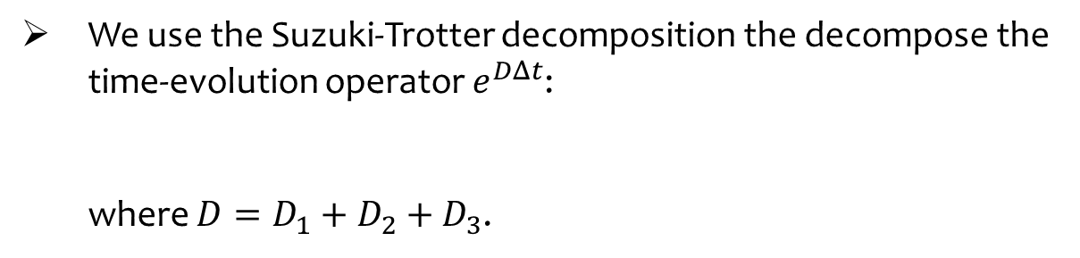
3) Current work at IMS: MD simulations
Bottleneck: Computing the forces $F_{i}$ - computational cost scales as $O(N^{2})$ to compute all $F_{i}$.
Hence, aim to reduce number of times $F_{i}$ is computed.
We use the Suzuki-Trotter decomposition the decompose the time-evolution operator $e^{DΔt}$:
where $D=D_{1}+D_{2}+D_{3}$.
$$e^{DΔt}=e^{D_{3}Δt/2}e^{D_{2}Δt/2}e^{D_{1}Δt}e^{D_{2}Δt/2}e^{D_{3}Δt/2}+O({\left(Δt\right)}^{3})$$
However, choice of sub-operators $D_{1}, D_{2}, D_{3}$ is not unique – we choose these such that it minimizes computation of $F_{i}$.
Additionally, computation of $F_{i}$ can be parallelized (using OpenMP) to further reduce computation time.

Slide 9


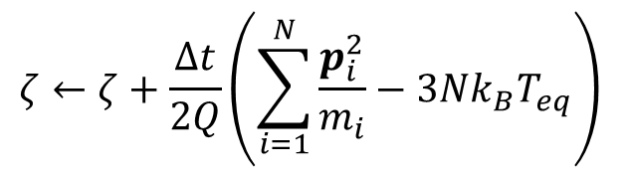




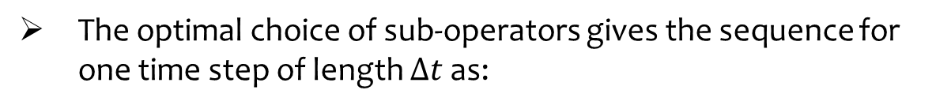

3) Current work at IMS: MD simulations
Numerical time-evolution of system:
$$\left(r_{i},p_{i},ζ\right)\left(t+Δt\right)=e^{DΔt}\left(r_{i},p_{i},ζ\right)(t)$$
The optimal choice of sub-operators gives the sequence for one time step of length $Δt$ as:
$$p_{i}←p_{i}+F_{i}Δt$$
$$p_{i}←p_{i}e^{−ζΔt/2}$$
$$r_{i}←r_{i}+p_{i}Δt/2m_{i}$$
$$r_{i}←r_{i}+p_{i}Δt/2m_{i}$$
$$ζ←ζ+\frac{Δt}{2Q}\left(\sum_{i=1}^{N}{\frac{p_{i}^{2}}{m_{i}}}−3Nk_{B}T_{eq}\right)$$
$$ζ←ζ+\frac{Δt}{2Q}\left(\sum_{i=1}^{N}{\frac{p_{i}^{2}}{m_{i}}}−3Nk_{B}T_{eq}\right)$$
$$p_{i}←p_{i}e^{−ζΔt/2}$$

Slide 10
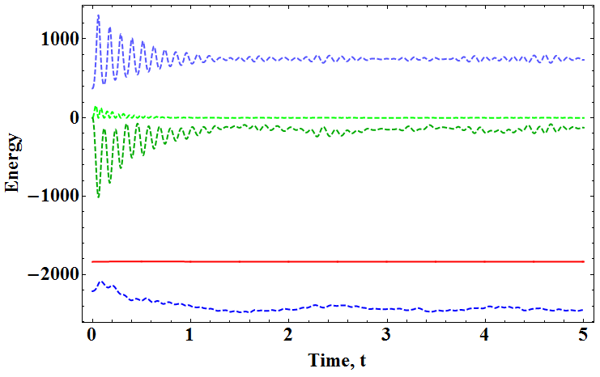
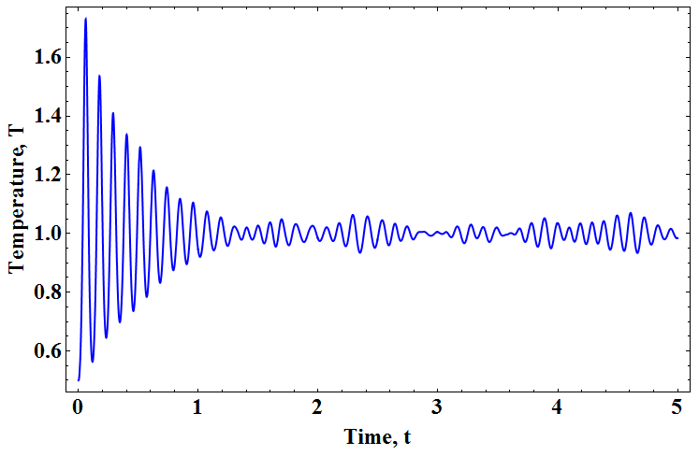
3) Current work at IMS: MD simulations
Choose parameters: $N=500$, $ρ=0.8$, $T_{eq}=1.0$, $T_{0}=0.5$, $Δt=0.001$
Results for $Q=1$:

Slide 11
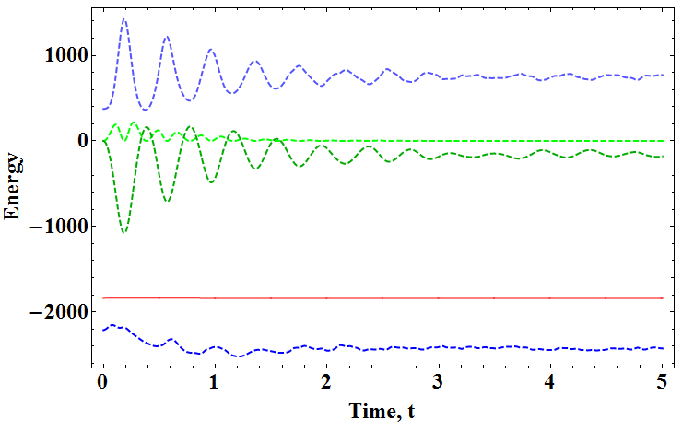
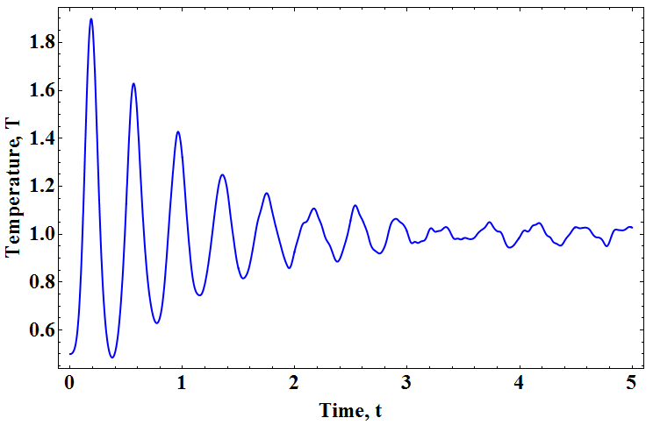
3) Current work at IMS: MD simulations
Results for $Q=10$:

Slide 12
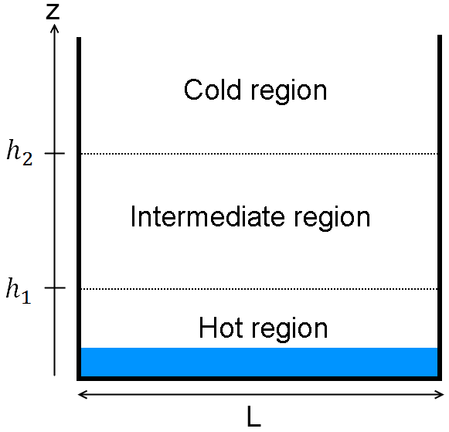
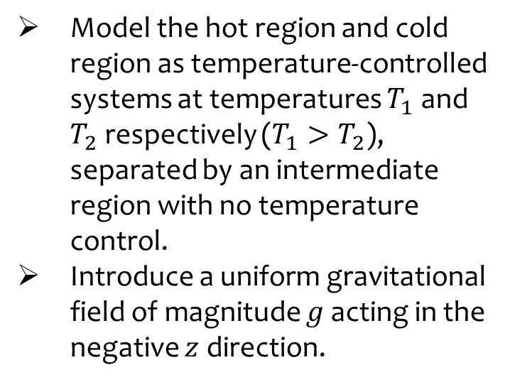
3) Current work at IMS: MD simulations
Now, consider the following (three-dimensional) system:
Model the hot region and cold region as temperature-controlled systems at temperatures $T_{1}$ and $T_{2}$ respectively ($T_{1}>T_{2}$), separated by an intermediate region with no temperature control.
Introduce a uniform gravitational field of magnitude $g$ acting in the negative $z$ direction.

Slide 13
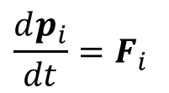

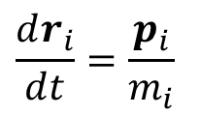

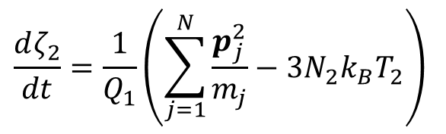

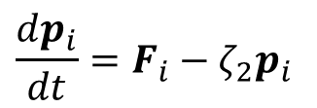
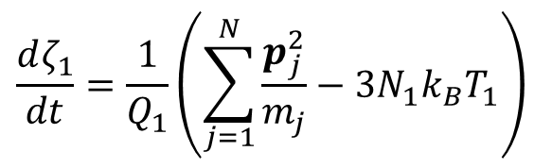


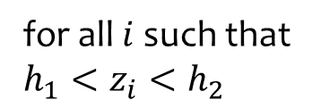
3) Current work at IMS: MD simulations
The equations of motion are now separate for each region:
$$\frac{dr_{i}}{dt}=\frac{p_{i}}{m_{i}}$$
$$\frac{dr_{i}}{dt}=\frac{p_{i}}{m_{i}}$$
$$\frac{dr_{i}}{dt}=\frac{p_{i}}{m_{i}}$$
$$\frac{dp_{i}}{dt}=F_{i}−ζ_{1}p_{i}$$
$$\frac{dp_{i}}{dt}=F_{i}$$
$$\frac{dp_{i}}{dt}=F_{i}−ζ_{2}p_{i}$$
$$\frac{dζ_{1}}{dt}=\frac{1}{Q_{1}}\left(\sum_{j=1}^{N}{\frac{p_{j}^{2}}{m_{j}}}−3N_{1}k_{B}T_{1}\right)$$
$$\frac{dζ_{2}}{dt}=\frac{1}{Q_{1}}\left(\sum_{j=1}^{N}{\frac{p_{j}^{2}}{m_{j}}}−3N_{2}k_{B}T_{2}\right)$$
for all $i$ such that $h_{1}<z_{i}<h_{2}$
for all $i$ such that $z_{i}<h_{1}$
for all $i$ such that $z_{i}>h_{2}$
Notes:
Make note of force calculation being inclusive of gravitational effects.

Slide 14
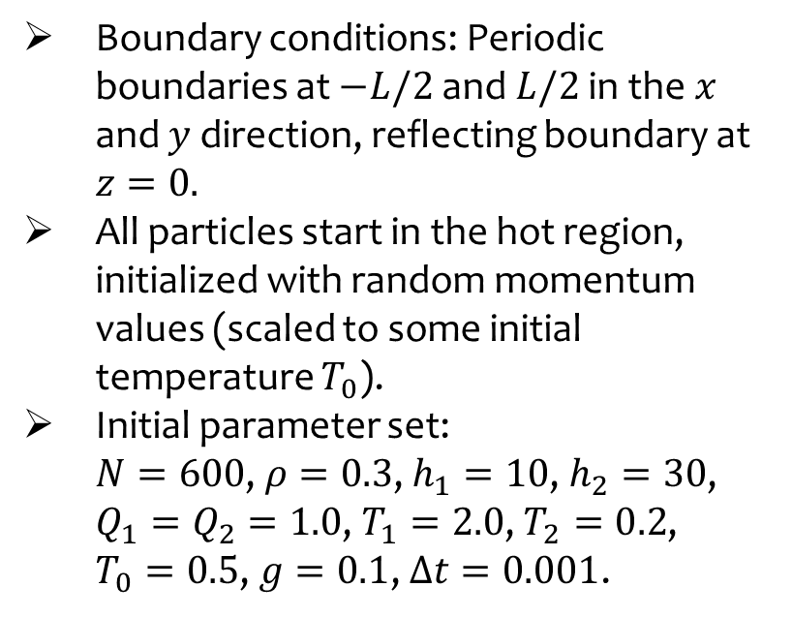
3) Current work at IMS: MD simulations
Boundary conditions: Periodic boundaries at $−L/2$ and $L/2$ in the$x$ and $y$ direction, reflecting boundary at $z=0.$
All particles start in the hot region, initialized with random momentum values (scaled to some initial temperature $T_{0}$).
Initial parameter set:
$N=600$, $ρ=0.3$, $h_{1}=10$, $h_{2}=30$, $Q_{1}=Q_{2}=1.0$, $T_{1}=2.0$, $T_{2}=0.2$, $T_{0}=0.5$, $g=0.1$, $Δt=0.001$.

Slide 15
3) Current work at IMS: MD simulations
INSERT VIDEO HERE

Slide 16
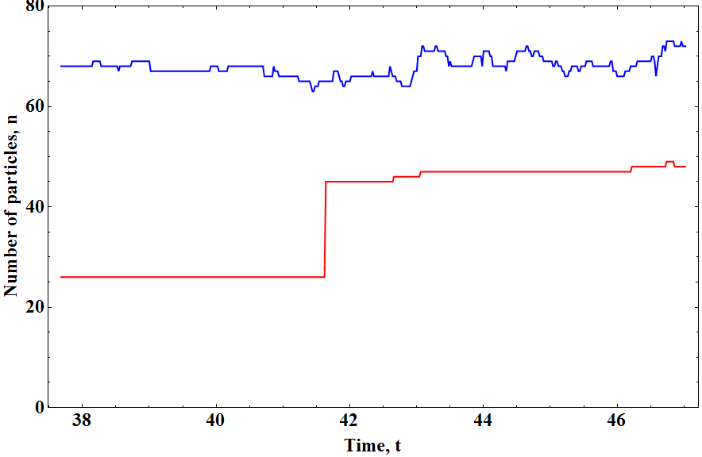
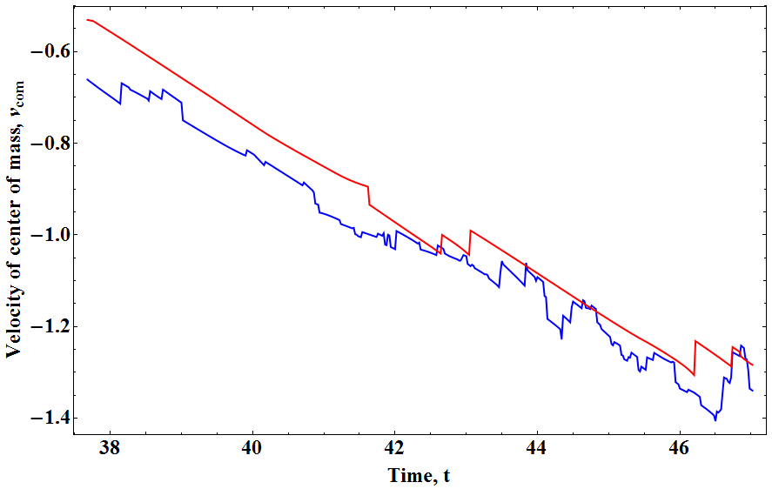
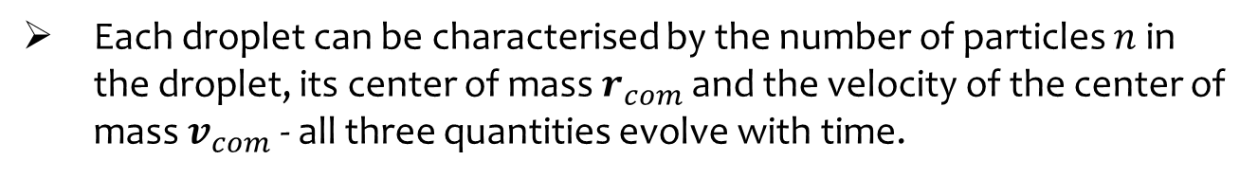
3) Current work at IMS: MD simulations
Each droplet can be characterised by the number of particles $n$ in the droplet, its center of mass $r_{com}$ and the velocity of the center of mass $v_{com}$ - all three quantities evolve with time.
Example: Droplet A (blue) and Droplet B (red) shown below

Slide 17
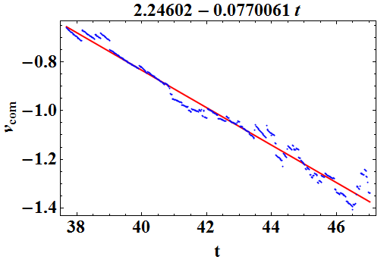
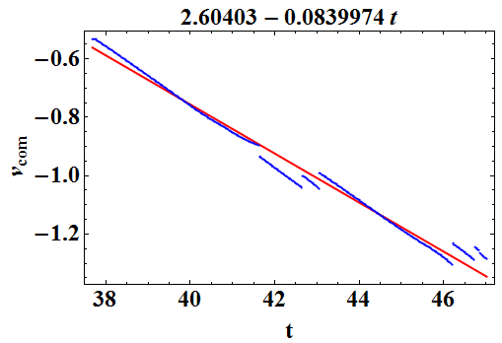

3) Current work at IMS: MD simulations
We use a linear least-squares fit to the velocity to obtain the acceleration of the droplets (recall that $g=0.1$):
Droplet A
Droplet B

Slide 18
3) Current work at IMS: MD simulations
So what?
Simulates the behaviour of a monoatomic Lennard-Jones fluid (e.g. inert gases like He, Ne, Ar, etc) under a gravitational field in different temperature-controlled regions.
Results show a cycle of heating the fluid to evaporate up to the cold region, formation of droplets (condensation) in the cold temperature region, droplets falling due to gravitational force, dispersion of droplets in hot temperature region, etc.
Model is similar to atmospheric conditions – hot temperature at low altitudes, cold temperature at high altitudes.

